Slide 1

Welcome to Deep Learning
Online Bootcamp
Working of Neural Network

Slide 2

Learning Objectives
Story time of A.N.N & Non Linear Boundary
Neural Network Architecture
Forward Propagation
Gradient Descent - Refresher
Backpropagation

Slide 3
The Story of a Neural Network, also known as Artificial Neural Network - A.N.N.

Slide 4
ANN
ANN is a unique computer who doesn’t want to be programmed like others. She wants to learn on her own, even if it takes longer and involves a lot of trial and errors.
Was she able to succeed? Watch the video to find out.

Slide 5

ANN

Slide 6
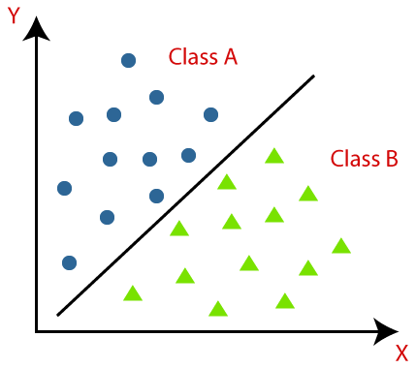
Classification
Classification is a process of dividing the given data points into two or more classes.
For example, in the given image we are classifying the data into two classes class A and class B.
The data in the image are classified with a straight line (i.e. linear boundary)

Slide 7
Non - Linear Boundary

Slide 8
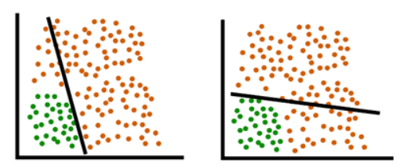
Non-linear Boundary
Both the models above are unable to classify our data into 2 classes because in both the cases the red points (significant in number) is present on the both sides of the line.
We thus need something better than a straight line to divide our data into 2 separate classes.

Slide 9
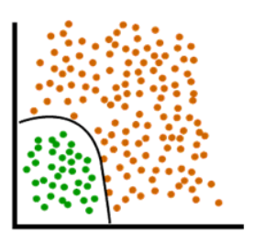
Non-linear Boundary
Realistic data is much more complex and not always classified by a straight line. For this purpose, we need a non-linear boundary to separate our data. Perceptron model works on the most basic form of a neural network, but for realistic data classification, we use Deep Neural Network or Multi Layer Perceptrons.

Slide 10
Neural Network Architecture

Slide 11
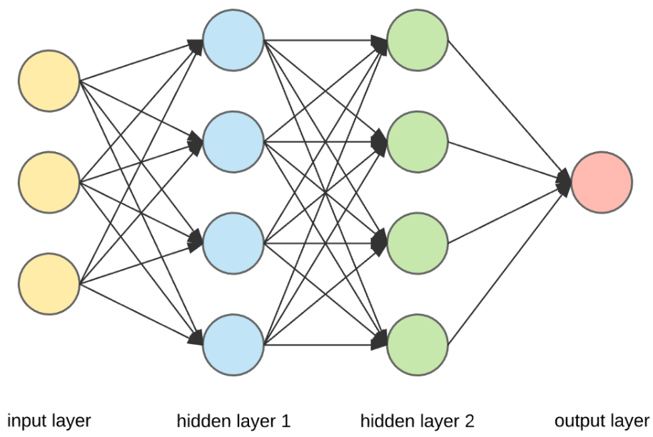
Neural Network: Architecture
Neural Networks are complex structures made of artificial neurons that can take in multiple inputs to produce a single output.
This is the primary job of a Neural Network
Simple terms, to transform input into a meaningful output
NN consists of an input and output layer with one or more hidden layers.

Slide 12
Neural Network Components
Outermost yellow layer is the input layer. A neuron is the basic unit of a neural network. In this case the input layer has three neurons. The inputs are simply the measure of our features. For example, in the boston house price data in the Linear Regression with tf.keras notebook, there were 13 input features, so the input layer will have 13 neurons.
This yellow layer is the input layer.

Slide 13
Neural Network Components
The blue layer and the green layer are two hidden layers which are not directly observable while building the neural network. The number of neurons in these hidden layers are initially assigned by us and we can find the optimal number of neurons in hidden layer through hyperparameter tuning.
This is the second hidden layer.
This blue layer is the first hidden layer.

Slide 14
Neural Network Components
The red layer is the output layer. This is the last layer of a neural network that produces the required output. For example, ‘MEDV’ (Median value of owner-occupied homes in 1000 USD's) was the output layer in boston house price dataset.
This is the output layer
Image source: UpGrad

Slide 15
Neural Network Components
Weights: There is some weight assigned for each connection. Weights represent scalar (constant) multiplication. Initially these are assigned randomly, then these weights are updated as per their importance in predicting the output. The updation of weight is done through back propagation (you will know this in upcoming slides).
Connection
Connection

Slide 16
Neural Network Components
Each circle in a layer is known as a neuron. The input layer has 3 neurons
Now we know each neuron in input layer has a value given in the dataset. Some random weights are assigned for each connection. When the value of each neuron in input layer is multiplied with its respective weight for the next connecting neuron and added all together, produces the value of next connecting neuron in the next layer. Don’t worry if you don’t understand here. An example of this calculation is shown in next slides.

Slide 17
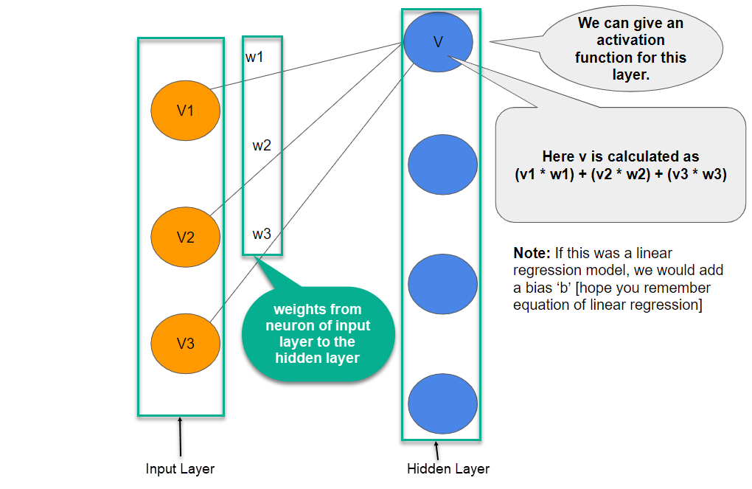

Calculating Value of a Neuron
A simple example on how the values of each neurons are calculated using weights and input values.
V
We can give an activation function for this layer.
w1
V1
Here v is calculated as
(v1 * w1) + (v2 * w2) + (v3 * w3)
w2
V2
w3
Note: If this was a linear regression model, we would add a bias ‘b’ [hope you remember equation of linear regression]
V3

Slide 18
Calculating Value of a Neuron
In the previous slide: w1 is the weight from first neuron of input layer to the first neuron of hidden layer. Same goes with w2 and w3
The value of each other neuron in each hidden layer is calculated in the same way we calculated the value of the first neuron of the first hidden layer in the previous slide.
Similarly, the value of output layer is calculated.

Slide 19
Let’s understand what we learnt using a simple task

Slide 20
Task - Making tea
Now imagine you are a Tea Master…….
The ingredients used to make tea (water, tea leaves, milk, sugar, and spices) are the “neurons” since they make up the starting points of the process. The amount of each ingredient represents the “weight.” Once you put in the tea leaves in the water and add the sugar, spices, and milk in the pan, all the ingredients will mix and transform into another state. This transformation process represents the “activation function.”

Slide 21
Hidden Layers and output Layer
The layer or layers hidden between the input and output layer are known as the hidden layers. It is called the hidden layer since it is always hidden from the external world. The main computation of a Neural Network takes place in the hidden layers. So, the hidden layer takes all the inputs from the input layer and performs the necessary calculation to generate a result. This result is then forwarded to the output layer so that the user can view the result of the computation.
In our tea-making example, when we mix all the ingredients, the formulation changes its state and color on heating. The ingredients represent the hidden layers. Here heating represents the activation process that finally delivers the result – tea.

Slide 22
Summary of Tea Example
Input layers: water, tea leaves, sugar, milk and spices
Hidden layers: all the above ingredients mixed with certain weights
Activation function: The heating process
Output layer: Tea

Slide 23
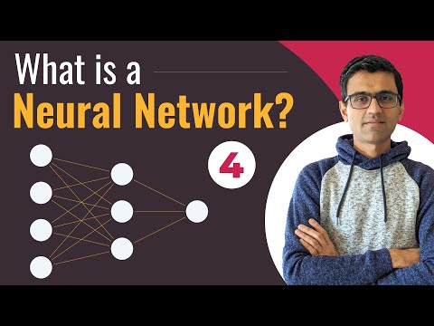
Another intuitive Explanation of Neural Networks

Slide 24
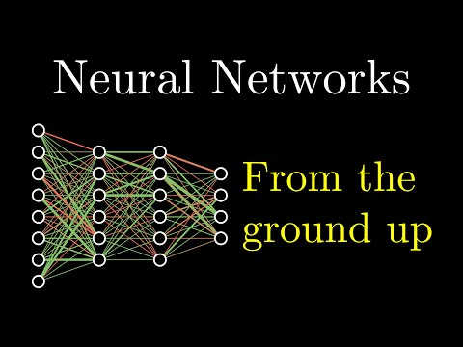
Explanation of Neural Networks (Optional)
If you like understanding things through Mathematics, this is for you! 😆

Slide 25
Working of a Neural Network

Slide 26
In the next set of slides, we will be discussing about the working on Neural Networks that includes 3 main steps:
Forward Propagation
Gradient Descent
Backward Propagation
What are they? These are the three important pillars of the neural network working and we will learn more about its prominence in next few slides.

Slide 27
Why Forward Propagation in NN?
In order to generate output or desired result, we need to feed input data. Forward propagation helps us do that in Neural Networks. The data in NN should be fed in the forward direction only.

Slide 28
Why Gradient Descent?
Just think of Gradient Descent as a technique to minimise the loss/cost function.
It helps in making the model perform better.

Slide 29
Why Backward Propagation in NN?
When you generate some output through forward propagation, there are some errors generated in the process. To reduce these errors, we traverse back from the output layer to input layer and update the initially assigned weights.

Slide 30
Forward Propagation

Slide 31
What is Forward Propagation in NN?
Well, if you break down the words, forward implies moving ahead and propagation is a term for saying spreading of anything.
Forward propagation means we are moving in only one direction, from input to the output, in a neural network.
Forward Propagation
Input Layer
Hidden Layer
Output Layer

Slide 32
What is Forward Propagation in NN?
The video in the next slide takes a Bank Transaction Dataset Example. The dataset has two features; number of children and accounts and the objective is to predict how many transaction will a user make at bank.
The video covers the following aspects:
How neural network model uses data to make predictions
How the information is transferred from input layer to the output layer (through weights and hidden layers)
The calculation of value of each neurons in hidden layers using weights and the input values
And finally calculating the output
Note: In the video, the inputs (2,3) and weight allocation (1, -1 etc) are randomly assigned for explanation. NO need to bother to know how they started appearing all at a sudden!

Slide 33
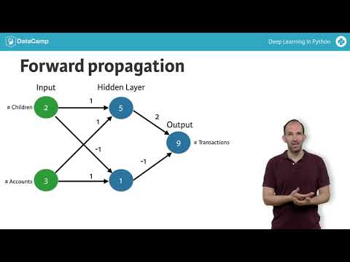
Working of Forward Propagation in NN

Slide 34
2. Gradient Descent Refresher

Slide 35
Gradient Descent
Gradient Descent!
Gradient Descent (GD) is an optimization technique in the machine learning process which helps us minimize the cost function by learning the weights of the model such that it fits the training data well.

Slide 36
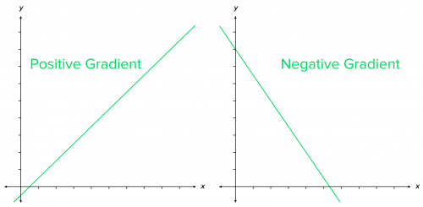
Gradient Descent - let’s break it down
Gradient = rate of inclination or declination of a slope (how steep a slope is and in which direction it is going) of a function at some point.
Descent = an act of moving downwards.
Simple way to memorize:
line going up as we move right → positive slope, gradient
line going down as we move right → negative slope, gradient

Slide 37
Gradient Descent- A technique to minimize cost
At the start, the parameter values of the hypothesis are randomly initialized (can be 0)
Then, Gradient Descent iteratively (one step at a time) adjusts the parameters and gradually finds the best values for them by minimizing the cost
In this case we’ll use it to find the parameters m and c of the linear regression model
m = slope of a line that we just learned about
c = bias : where the line crosses the Y axis.

Slide 38
Gradient Descent - An Example
Imagine a person at the top of a mountain who wants to get to the bottom of the valley below the mountain through the fog (he cannot see clearly ahead and only can look around the point he’s standing at)
He goes down the slope and takes large steps when the slope is steep and small steps when the slope is less steep.
He decides his next position based on his current position and stops when he gets to the bottom of the valley which was his goal.

Slide 39
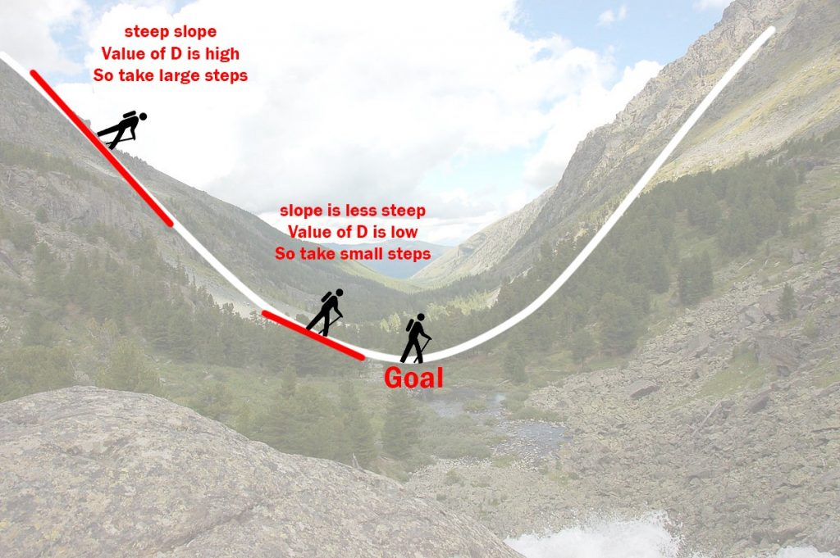
Gradient Descent

Slide 40
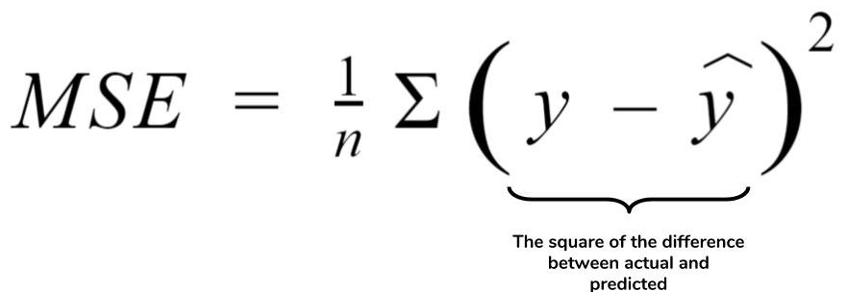
Gradient Descent in action
Y = m*x
m
Now, think of the valley as a cost function.
The objective of GD is to minimise the cost function (by updating it’s parameter values). In this case the minimum value would be 0.

Slide 41
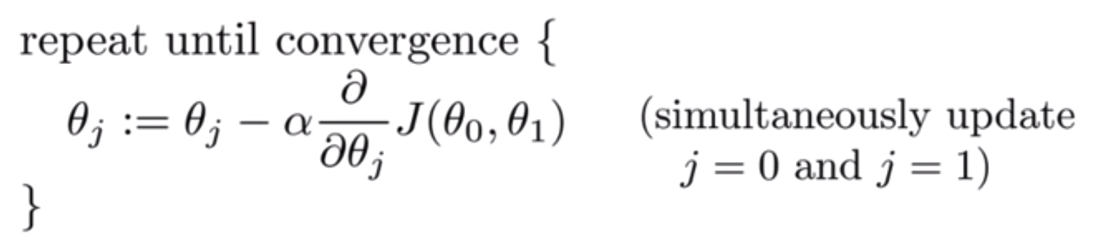
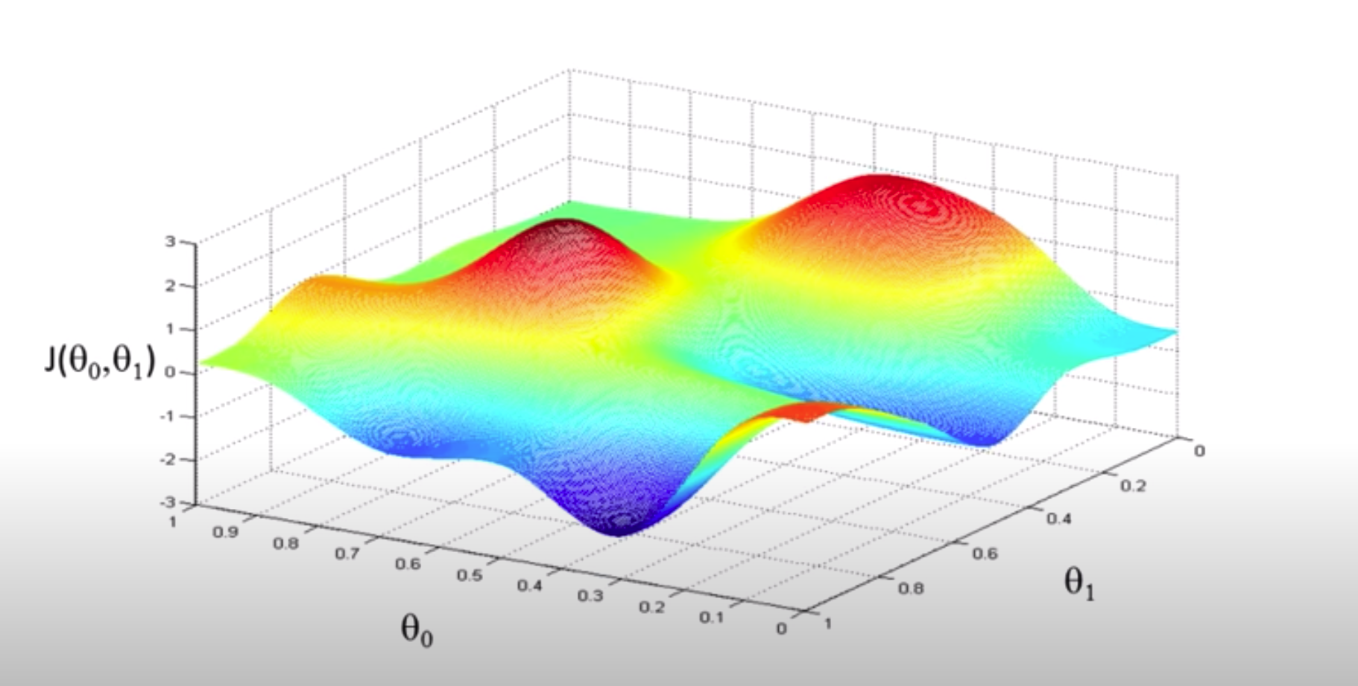
What does a cost function look like?
J is the cost function, plotted along it’s parameter values. Notice the crests and troughs.

Slide 42
How we navigate the cost function via GD

Slide 43
3. Backward Propagation

Slide 44
What is Backward Propagation in NN?
Backward propagation means we are moving in only one direction, from output to the input, in a neural network.
Backward propagation is also called as Back Propagation in short.
Backward Propagation
Input Layer
Hidden Layer
Output Layer

Slide 45
NOTE: Stochastic Gradient Descent (SGD) that the instructor is sometimes mentioning in the next video is just a type of Gradient Descent. Don’t worry about its exact working.

Slide 46
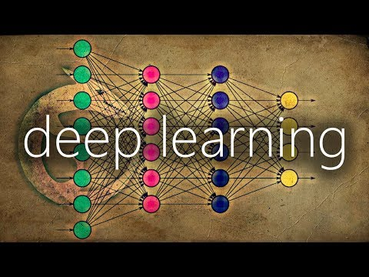
What is Backward Propagation in NN?

Slide 47
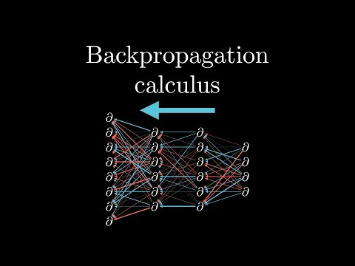
Backpropagation Calculus (Optional)
If you like understanding things through Mathematics, this is for you! 😆

Slide 48
Summarising the working of a NN
A Neural Network passes data to model via forward propagation.
When it reaches the last(output) layer, it calculates loss on output.
It then back propagates information about the loss/error, in reverse through the network to the input layer, so that it can alter the parameters weights.
Gradient Descent is calculated via backpropagation and works to minimise this loss:
By calculating gradient of loss function according to weights
Updating weights accordingly

Slide 49
Download link to slides
https://docs.google.com/presentation/d/1MdDc4LV6koLabzwoyiwDoFCJJb4_eRVqV_TPfaMQBWQ/edit?usp=sharing

Slide 50
That’s it for this unit. Thank you!
Feel free to post any queries on Discuss or in the #help channel on Slack

